Slide 1


COMPANY
PRESENTATION
Ngen: Your bridge to energy self-sufficiency.

Slide 2

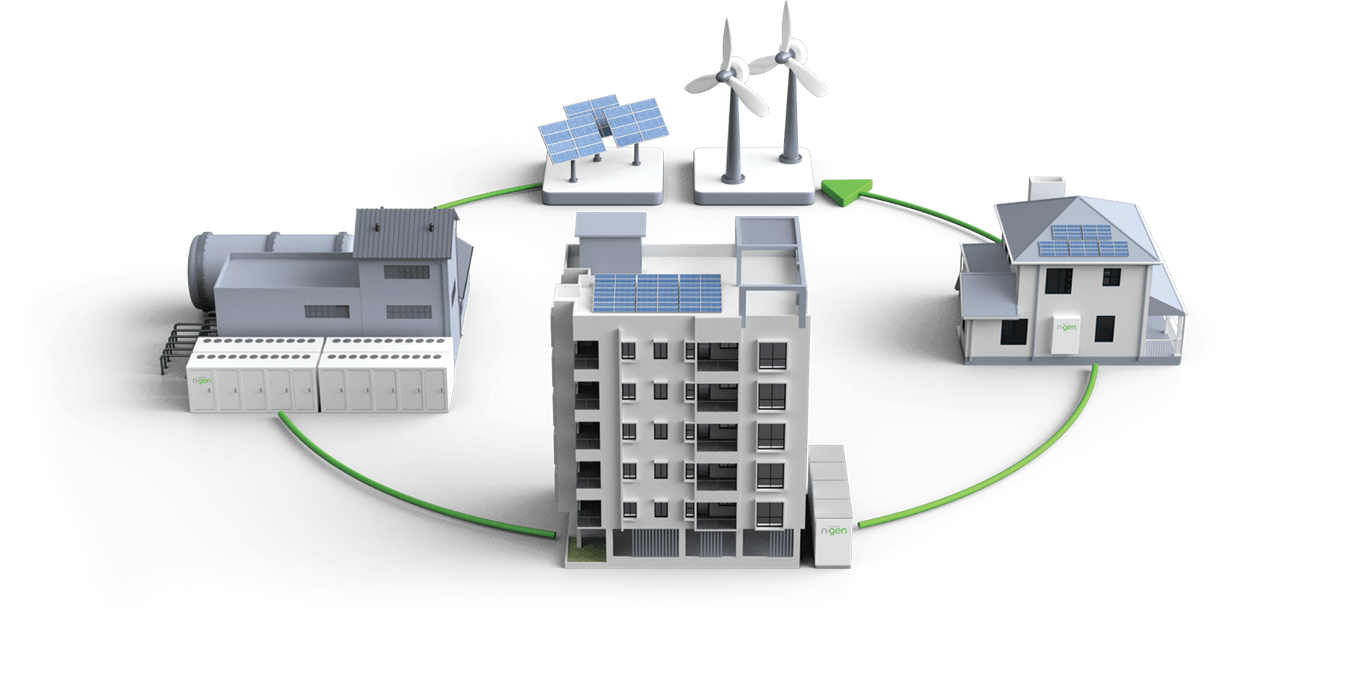
NGEN VISION
Full digitalisation of energetics
Decentralisation of European energy system
Linking energy producers, distributors, transmission system and consumers
Consumption optimisation
Increasing energy independancy
Carbon footprint reduction

Slide 3
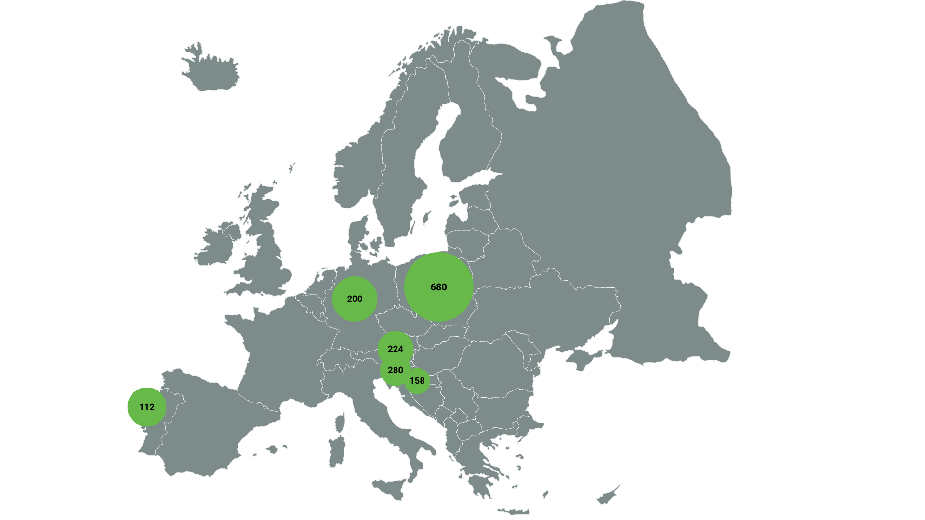

Start of construction 2024/25/26
Expected start of construction
1,6
GWh of build systems until 2026

Slide 4
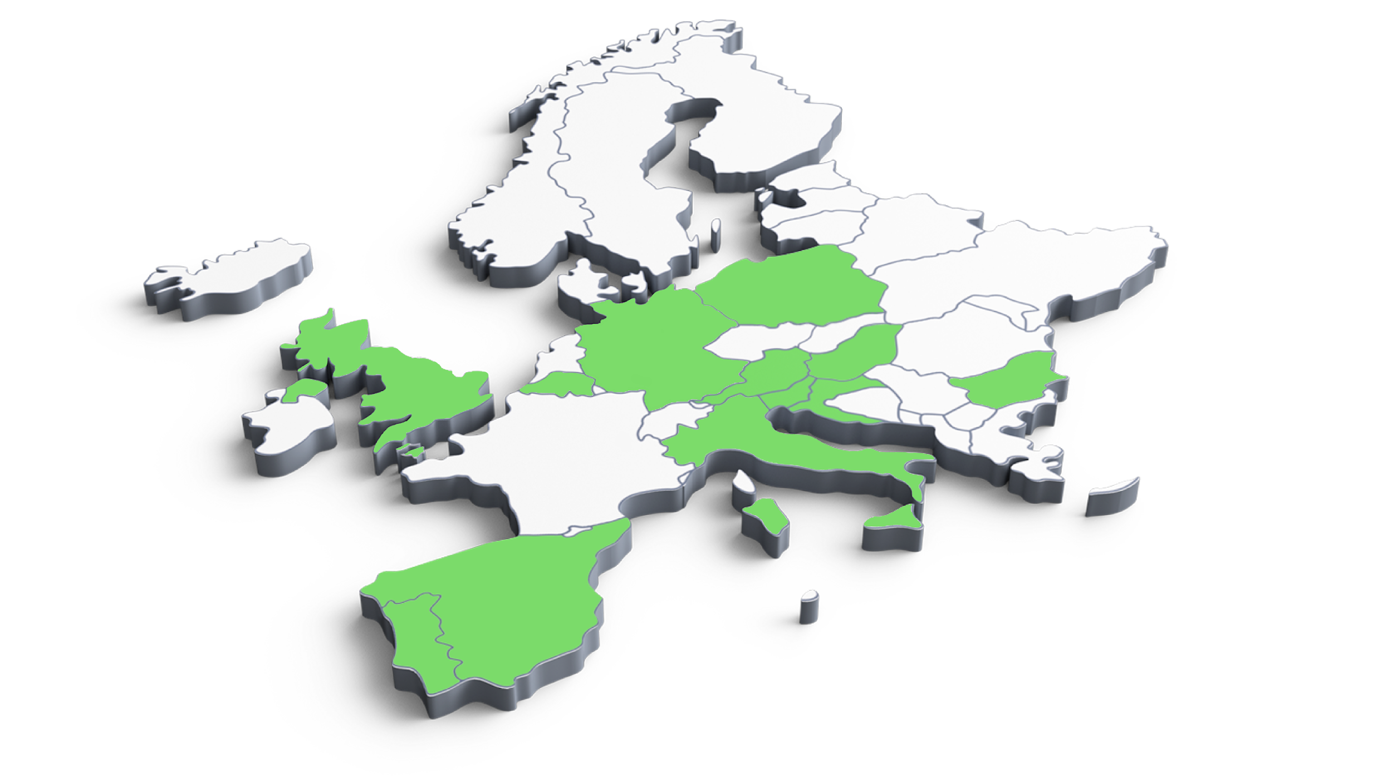
Projects development by country
11,5
GWh of leads in 8 countries
680
280
224
78
200
5
108
80
112
20
20
Slovenia
Austria
Croatia
Portugal
Poland
Germany

Slide 5
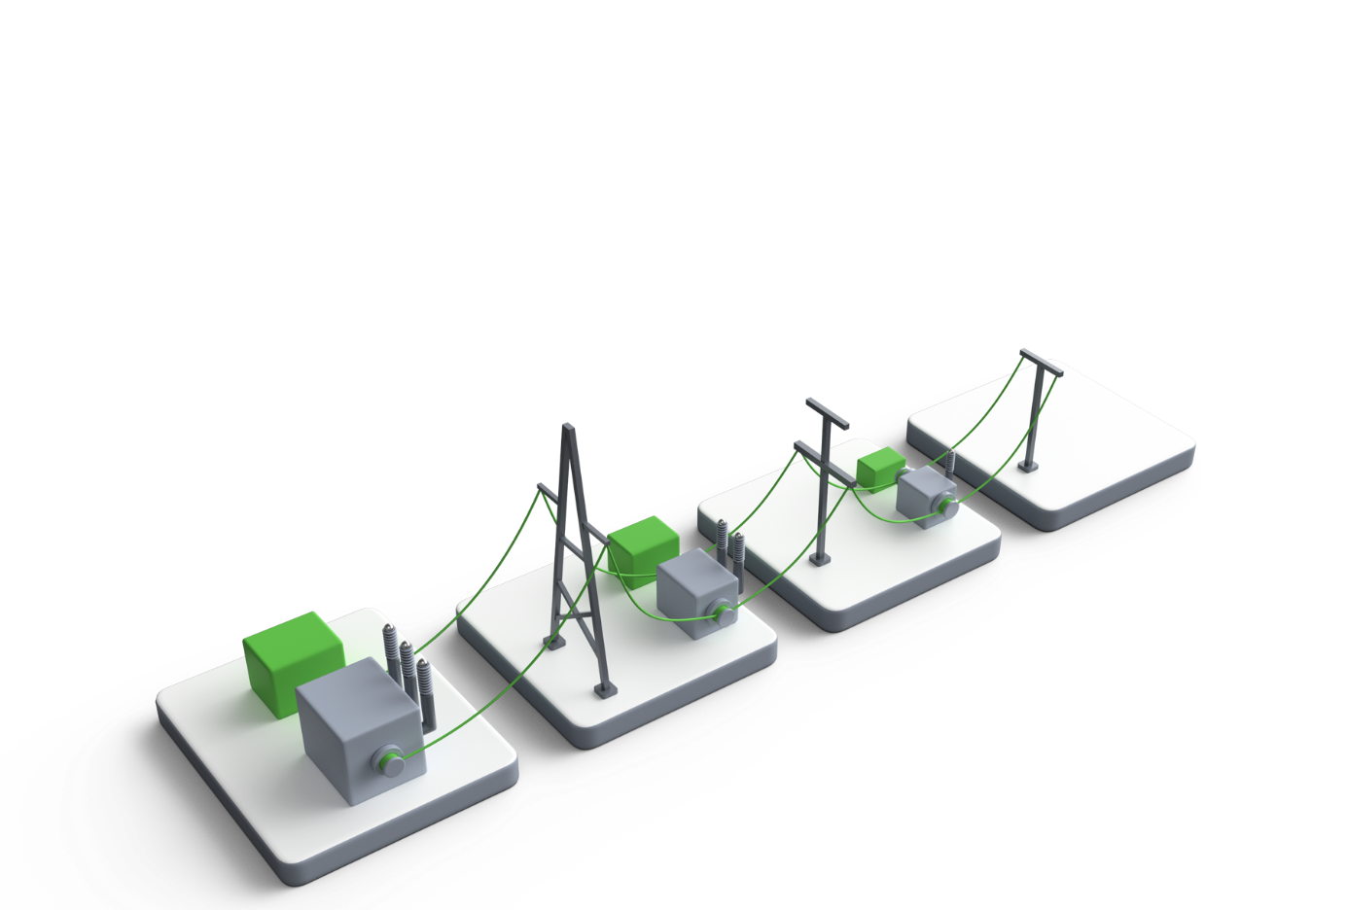
What We do?
TSO
Electricity producers from renewables
Ancillary services
aFRR
mFRR
Providing capacity/power
Production shifting
Balancing
Providing services to TSO
Additional installation power

Slide 6
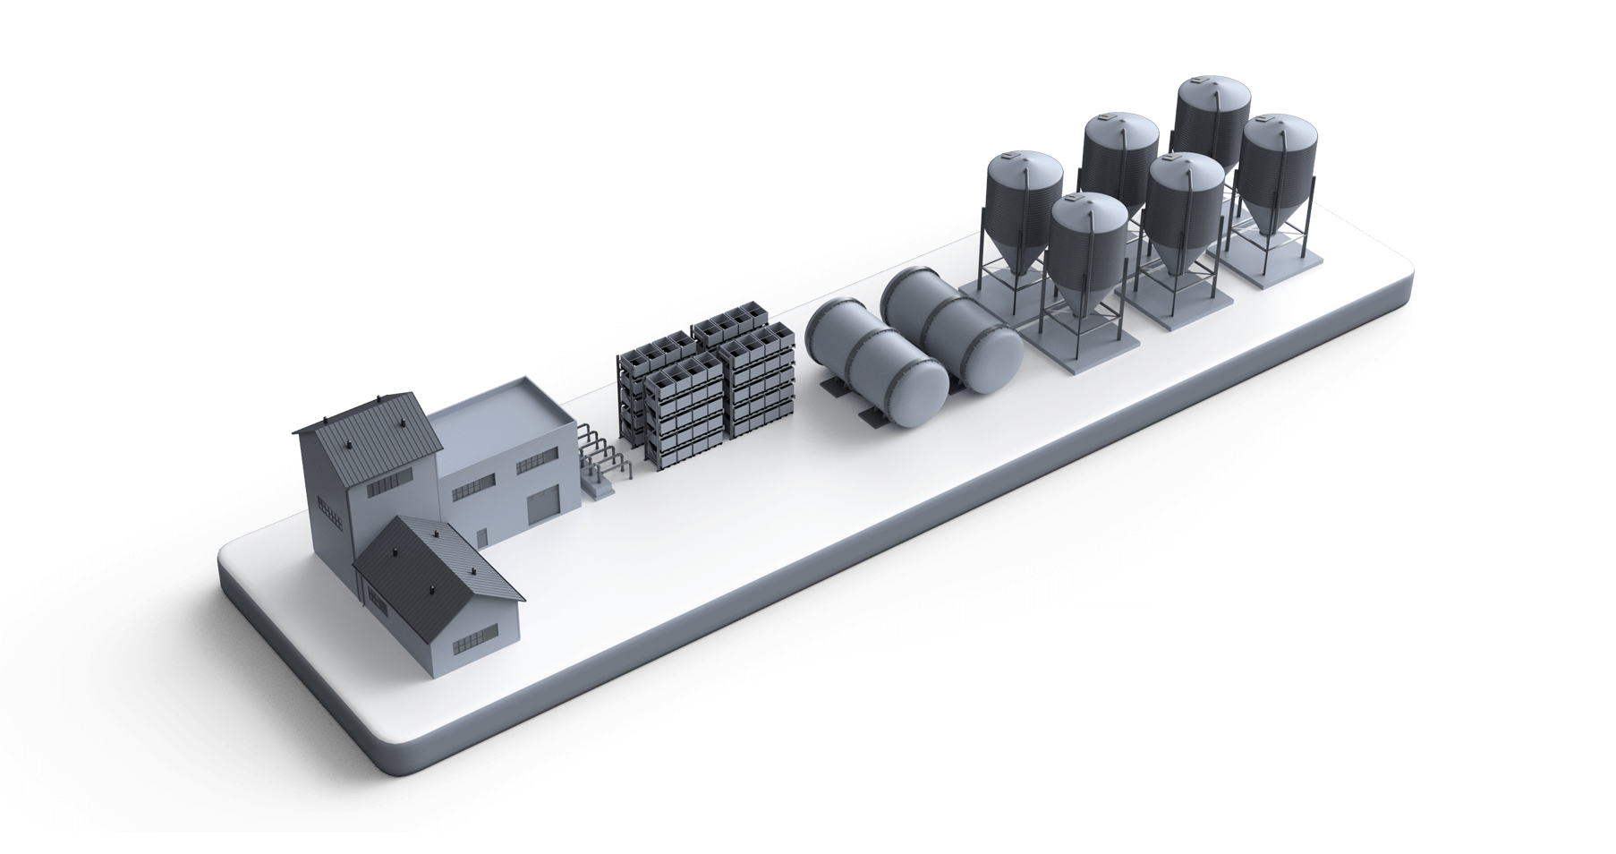
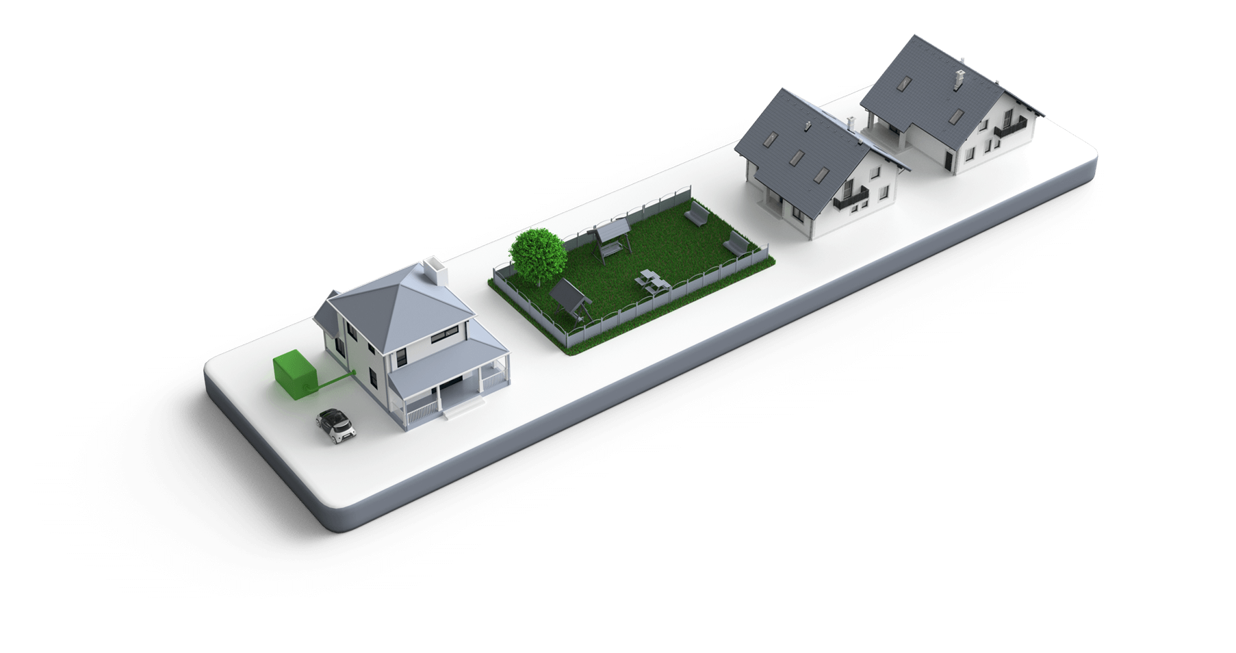
What We do?
B2B, Industrial sector
Peak shaving
Load shifting
Backup power
Using dynamic prices
Demand-response
Households
Self-sufficient system
Peak shaving
Load shifting
Backup power
Using dynamic prices
Demand-response

Slide 7
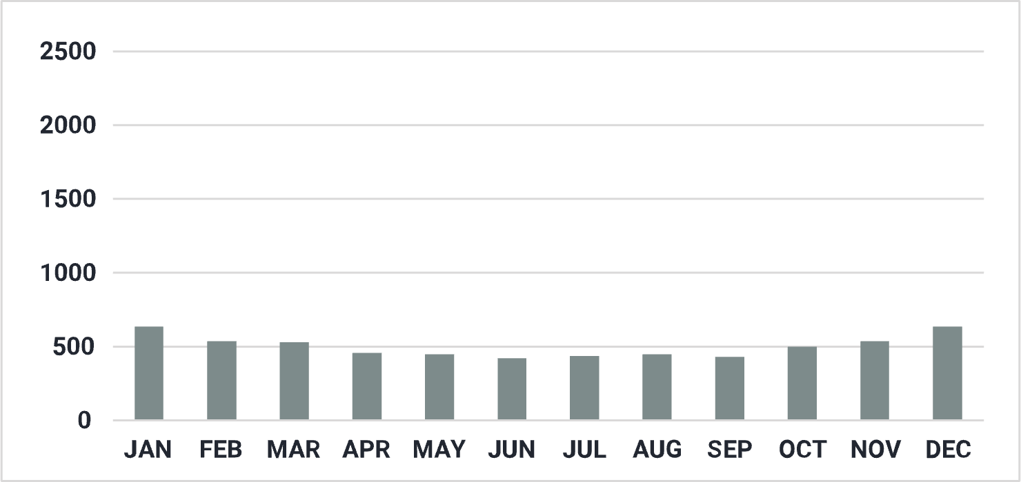
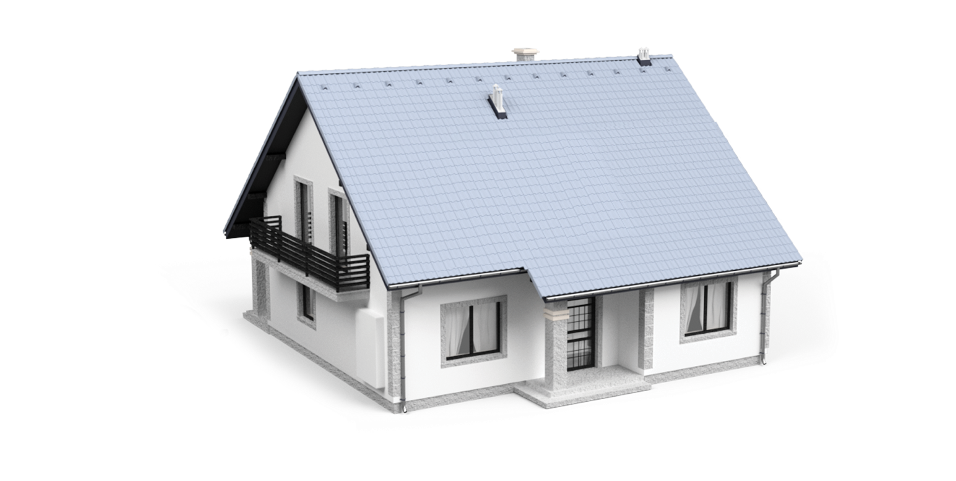
Consumption Comparison
Scenario 1: JUST CONSUMPTION
Average household consumption.
Total consumption : 5.999 kWh
* all numbers are in [kWh]

Slide 8
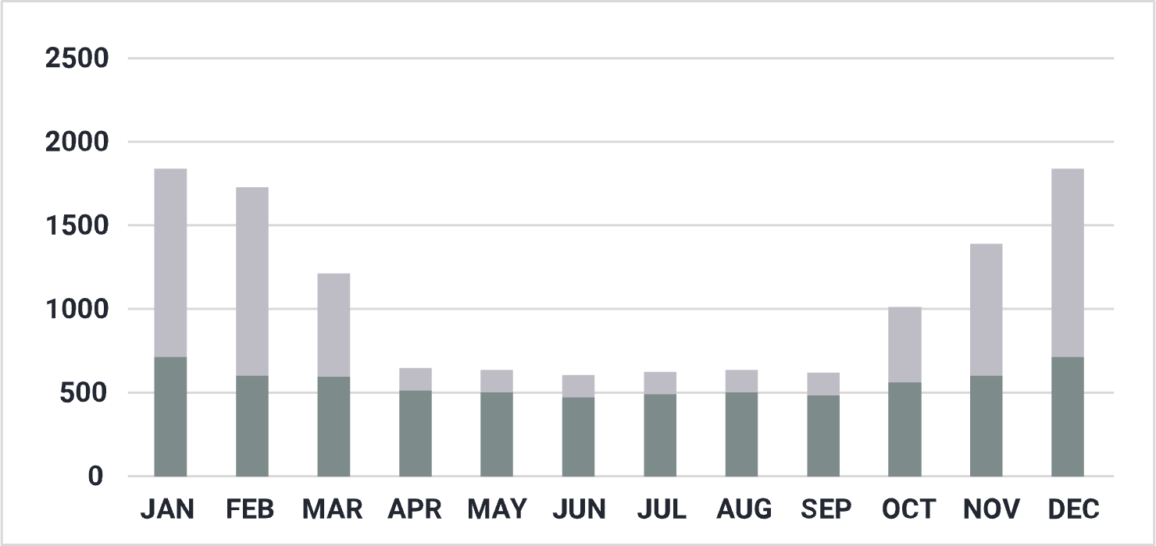

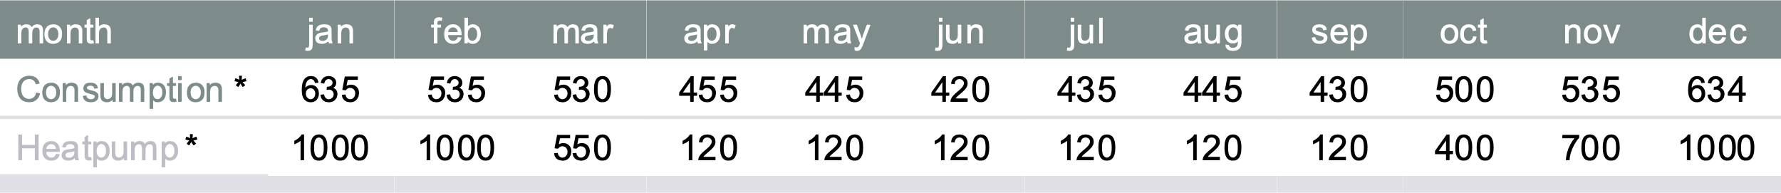
Consumption Comparison
Scenario 2: ADDED HEAT PUMP
Average household consumption with a heat pump.
Total consumption : 11.369 kWh
* all numbers are in [kWh]

Slide 9
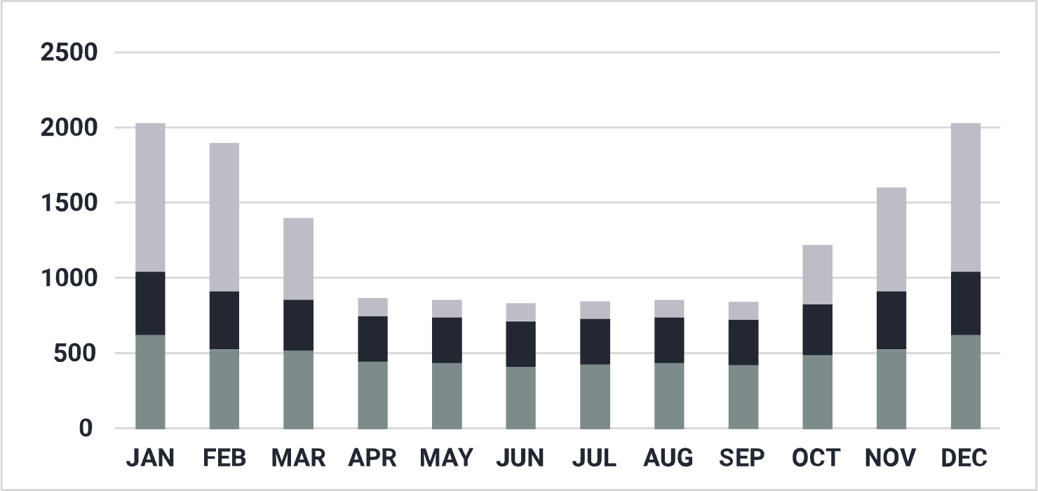
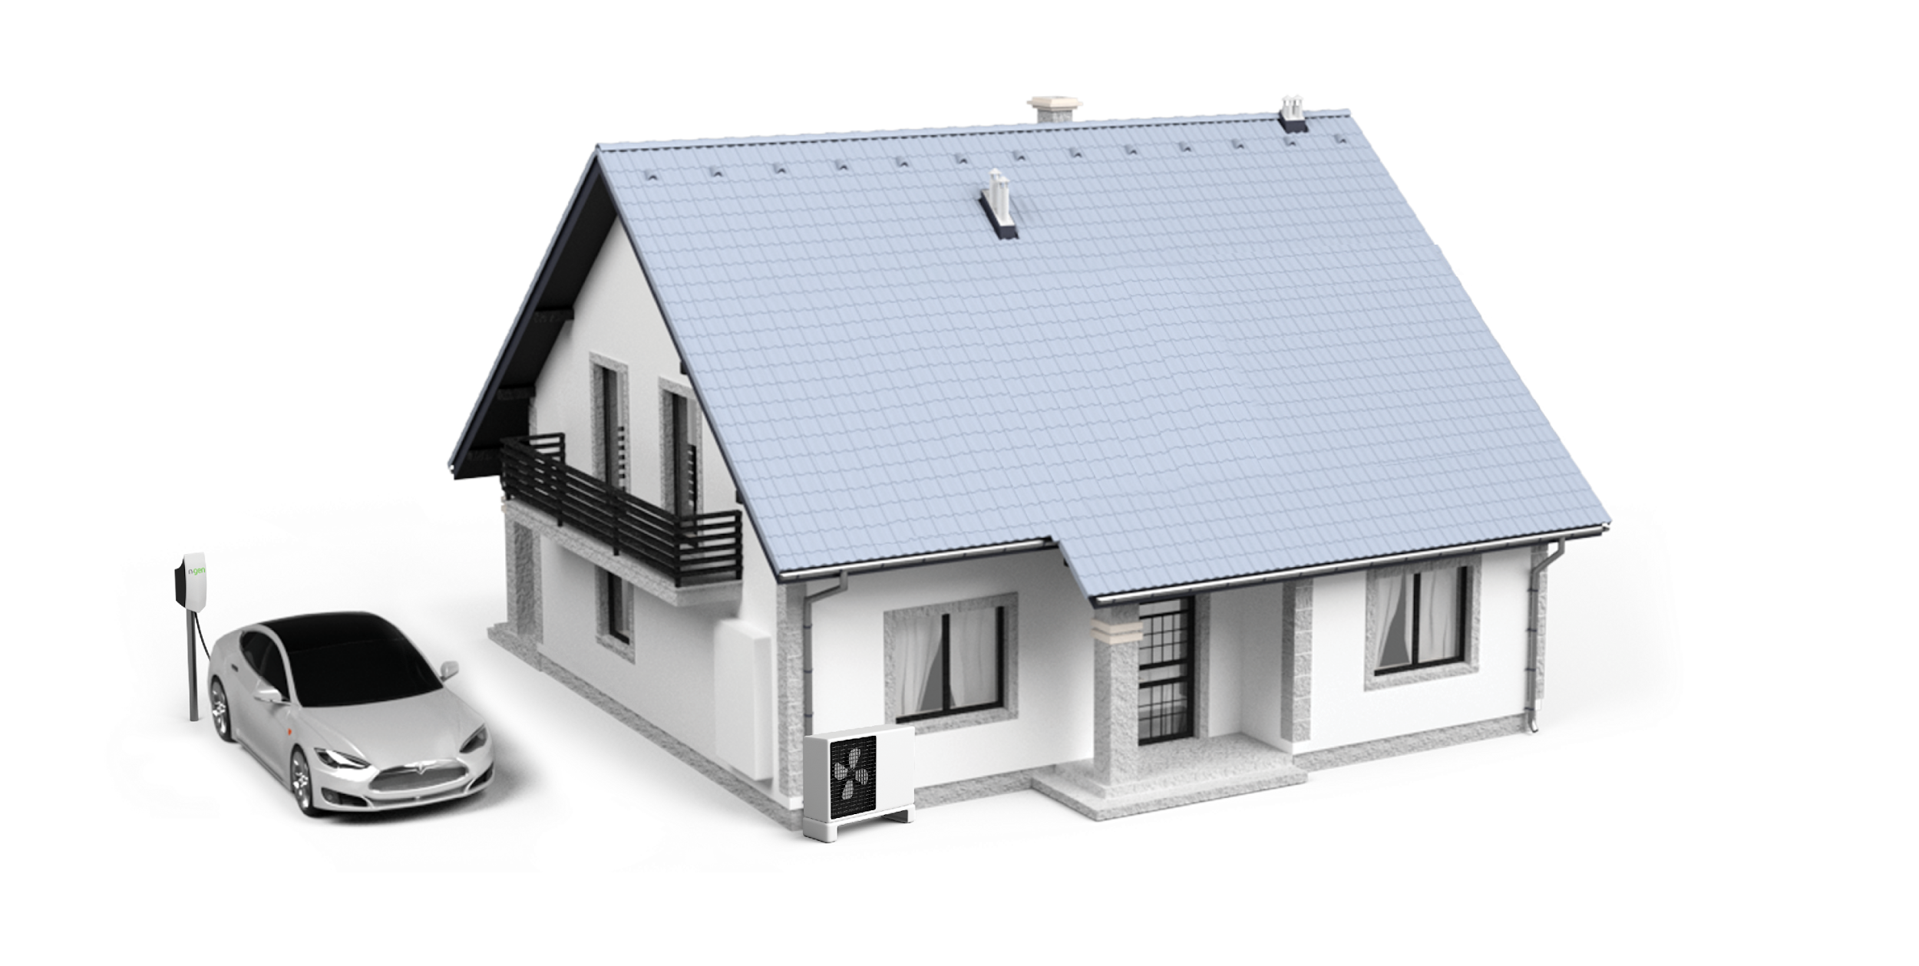
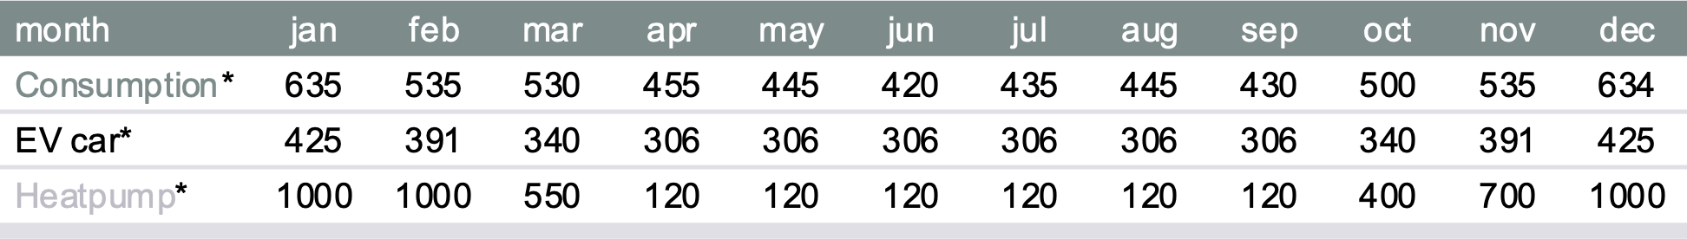
Consumption Comparison
Scenario 3: ADDED EV CAR
Average household consumption with a heat pump and an eletric car.
Total consumption : 15.517 kWh
* all numbers are in [kWh]

Slide 10
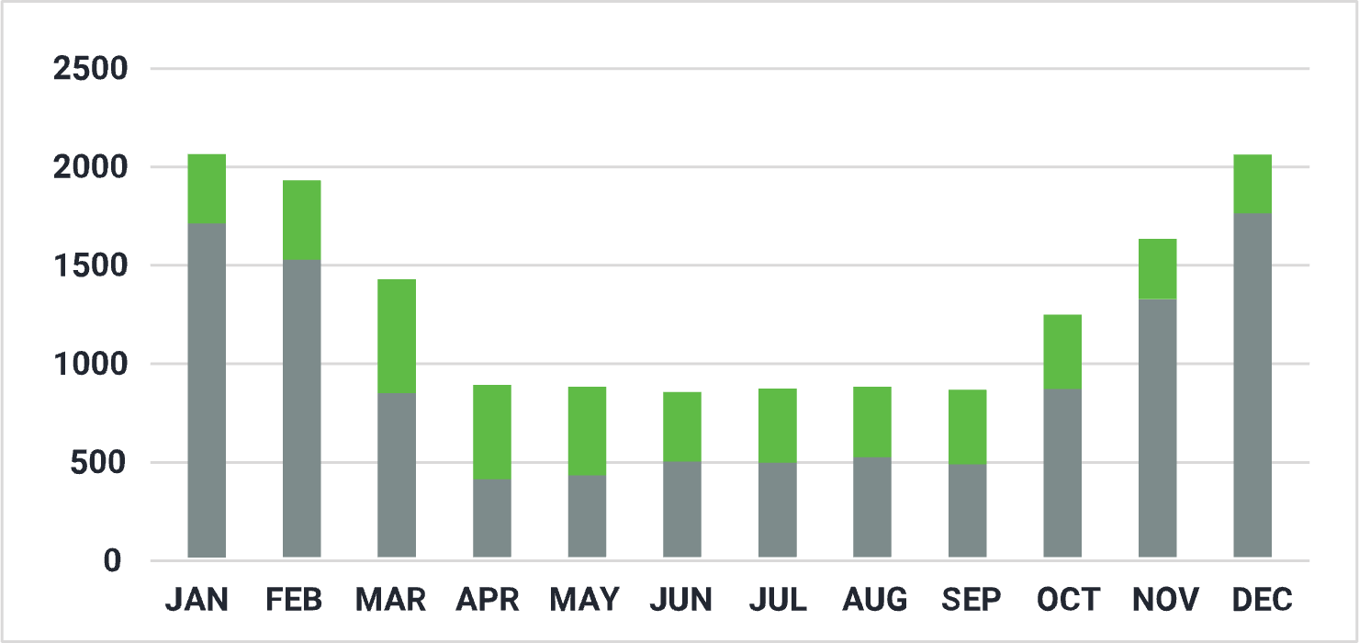
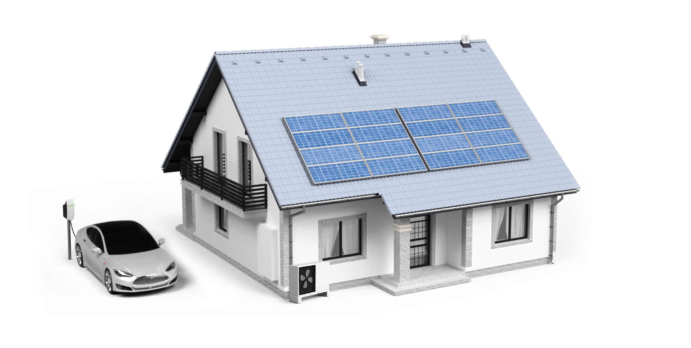
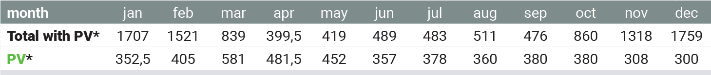
Consumption Comparison
Scenario 4: INSTALLED 10KW PV
Average household consumption with a heat pump and an eletric car. Installed 10kW solar panels.
Total consumption : 10.782 kWh
* all numbers are in [kWh]

Slide 11
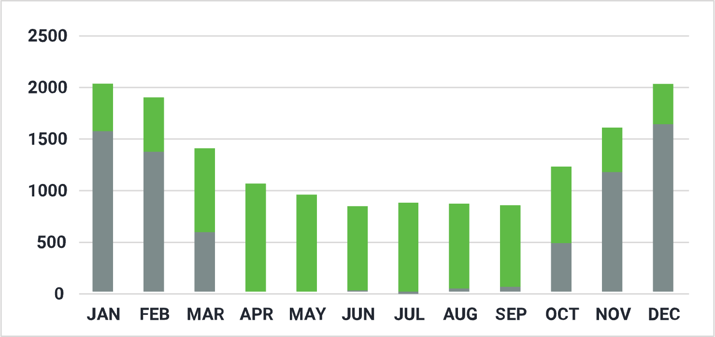

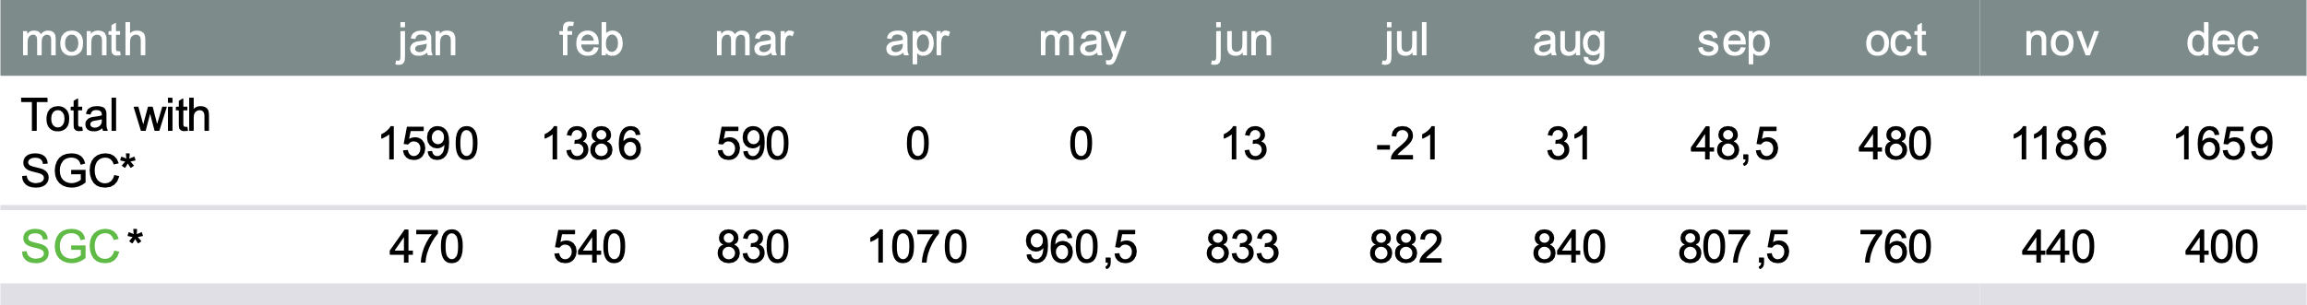

Consumption Comparison
Scenario 5: INSTALLED SG CONNECT
Average household consumption with a heat pump and an eletric car. Installed 10kW solar panels. Utilization of the SG Connect system.
Total consumption : 6.684 kWh
* all numbers are in [kWh]

Slide 12


Slide 13
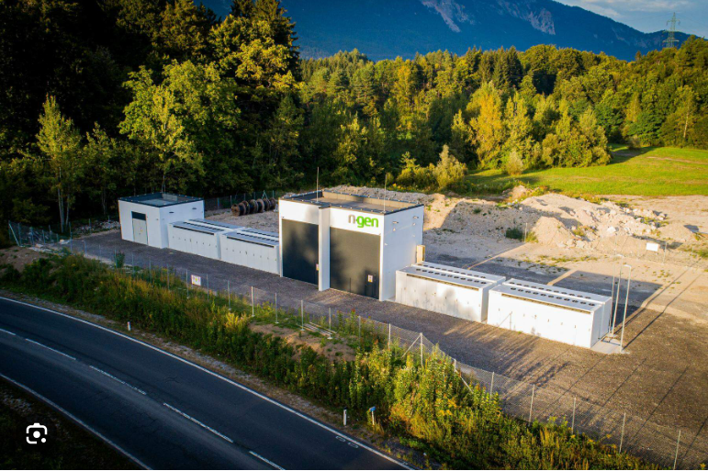
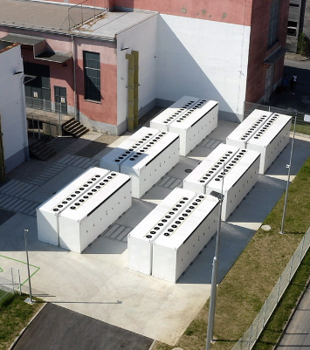
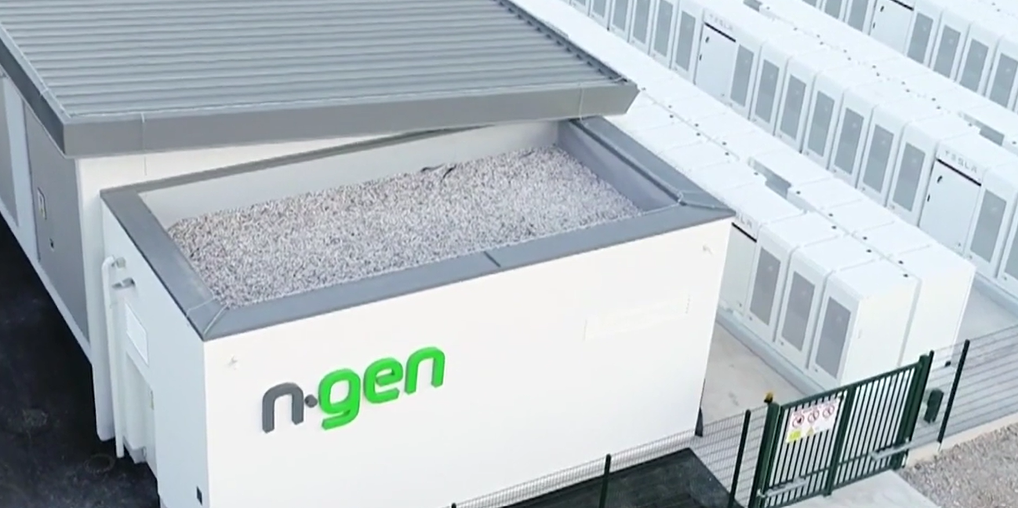
Austria/Arnoldstein
20 MWh (in operation)
Slovenia/Maribor
22 MWh (in operation)
e
Slovenia/Jesenice
22 MWh (in operation)

Slide 14
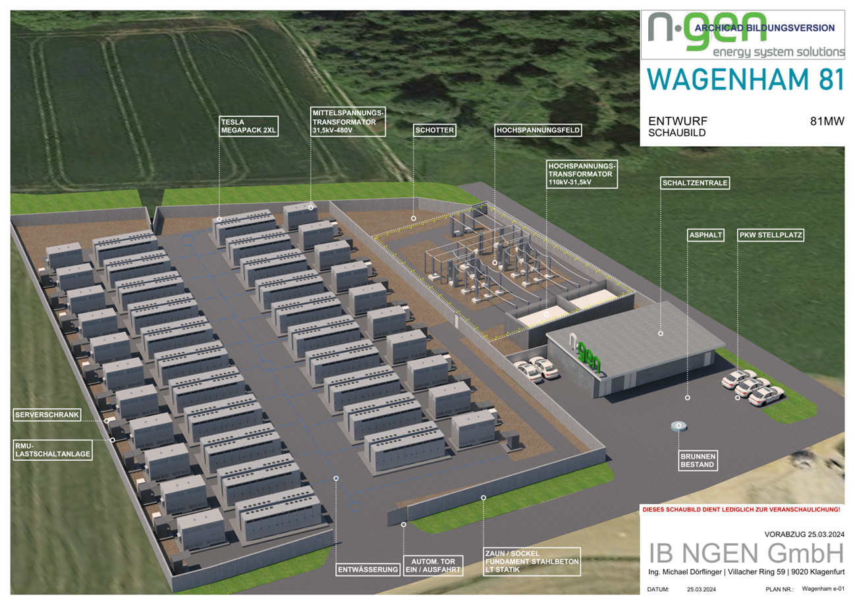
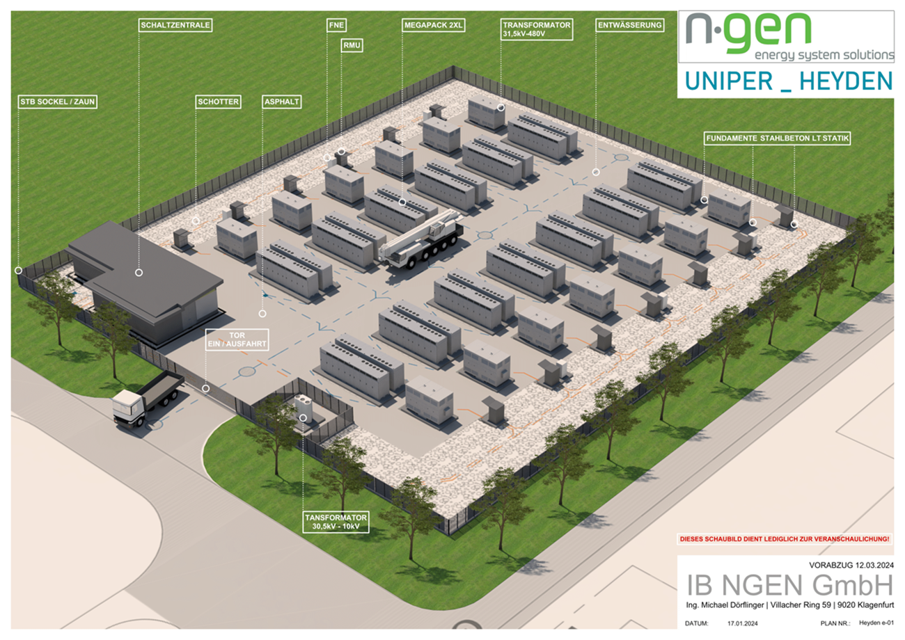

Slide 15
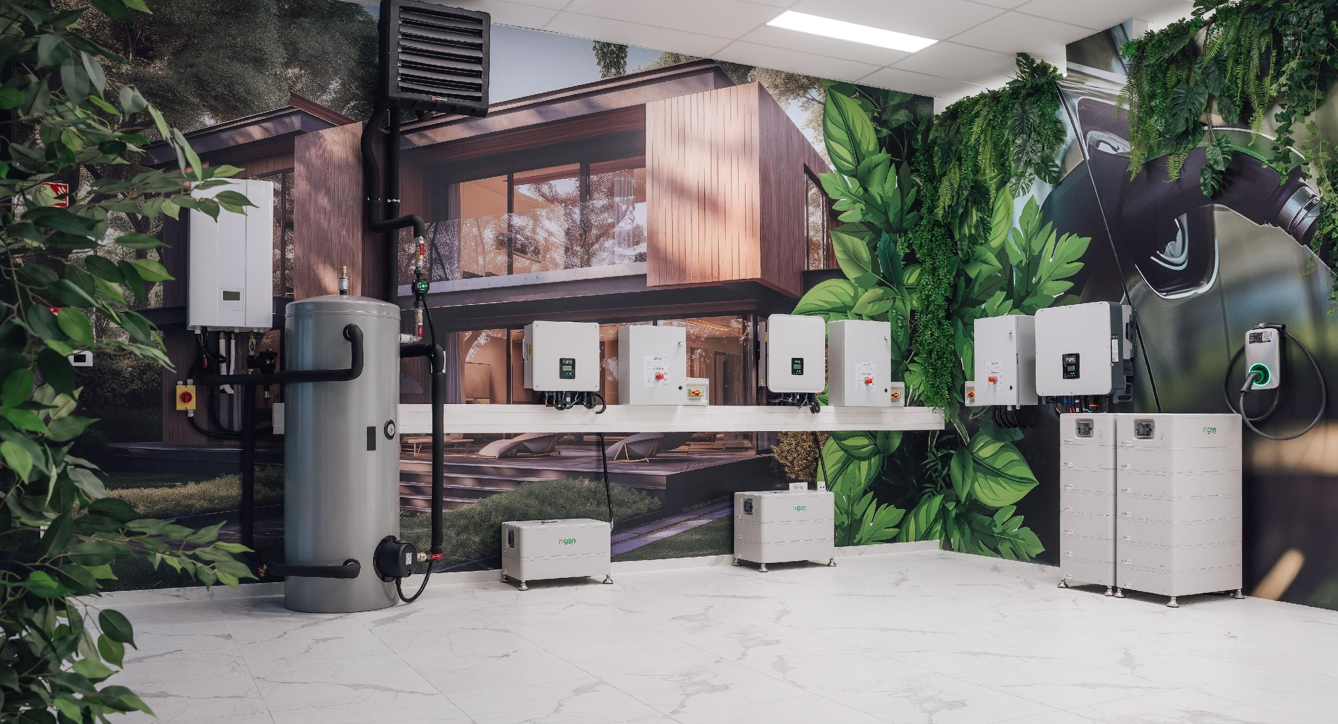
e
SG demo center

Slide 16
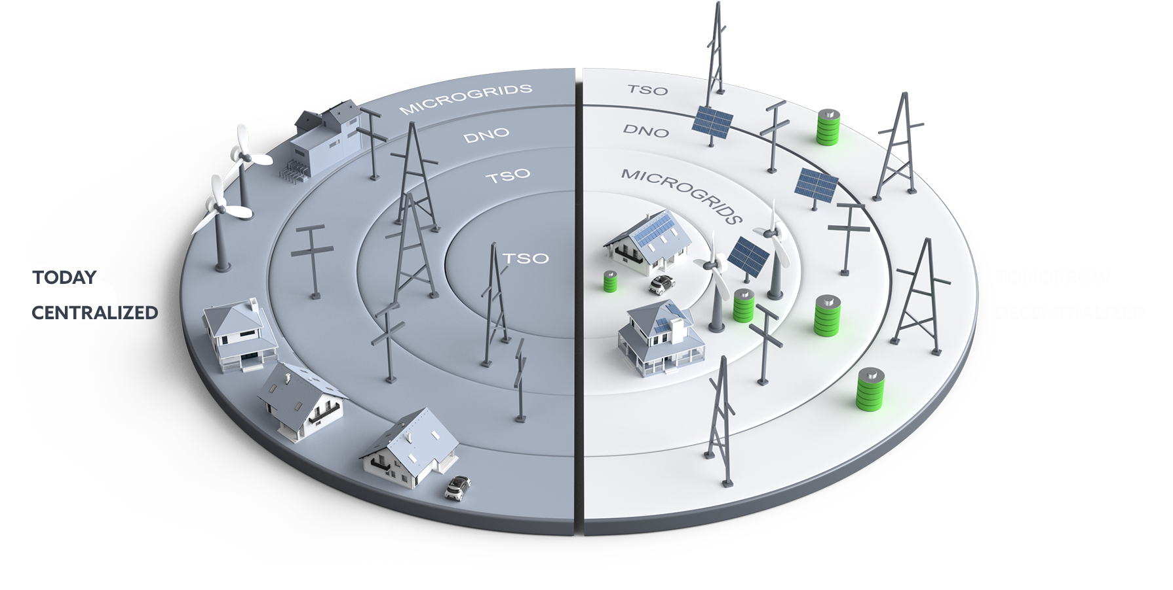
TODAY vs TOMORROW

Slide 17
THANK YOU FOR YOUR ATTENTION
For more info go to: www.ngen-group.eu

